Slide 1
19CS2109
COMPUTER NETWORKS AND SECURITY

Slide 2
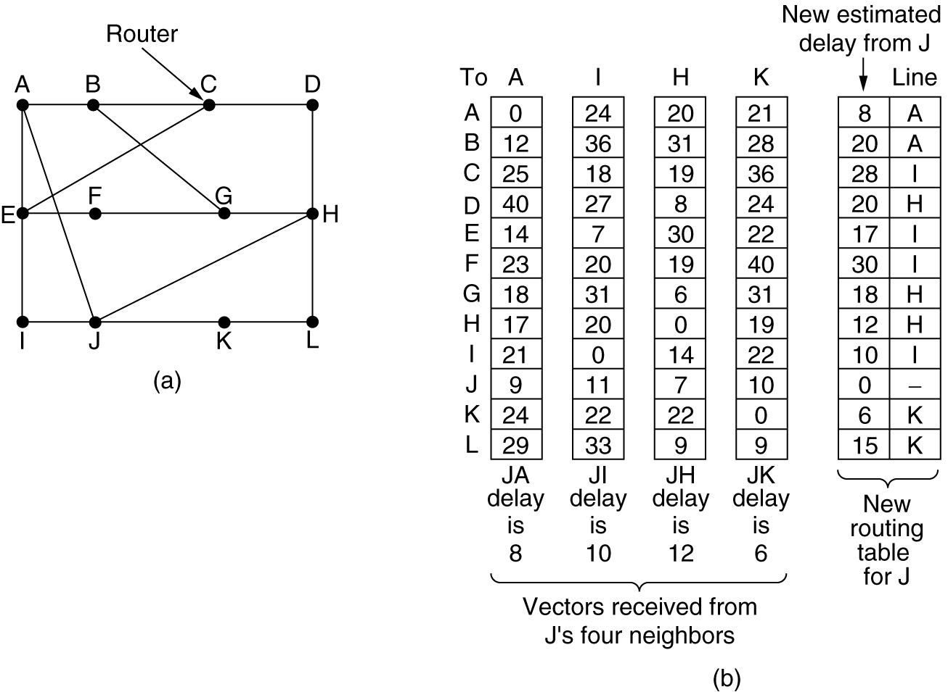
Distance Vector Routing
(a) A subnet. (b) Input from A, I, H, K, and the new
routing table for J.

Slide 3
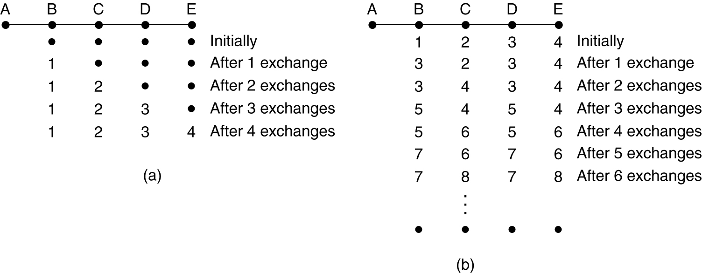
Distance Vector Routing (2)
The count-to-infinity problem.

Slide 4
Link State Routing
Each router must do the following:
Discover its neighbors, learn their network address.
Measure the delay or cost to each of its neighbors.
Construct a packet telling all it has just learned.
Send this packet to all other routers.
Compute the shortest path to every other router.

Slide 5
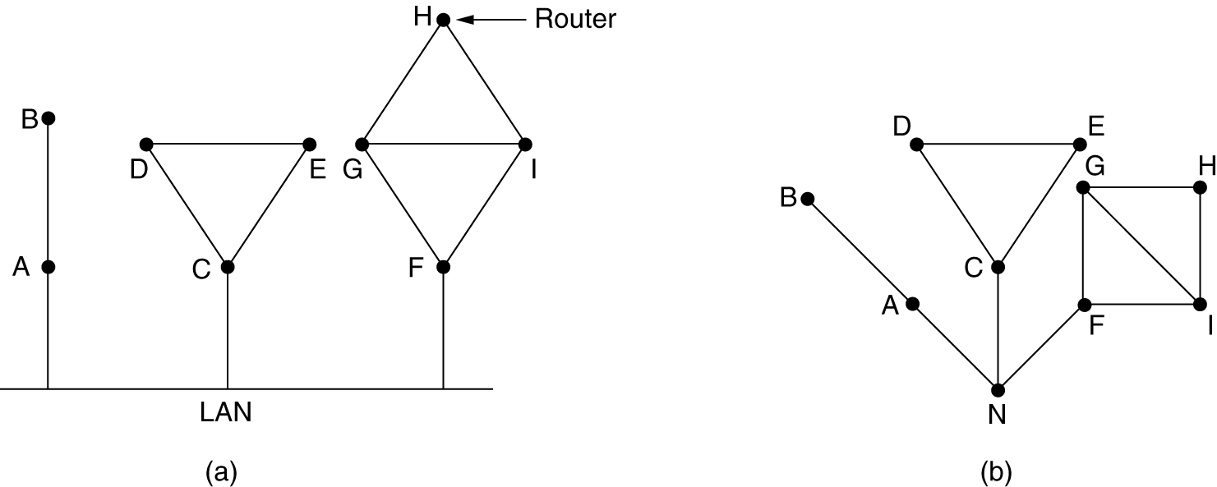
Learning about the Neighbors
(a) Nine routers and a LAN. (b) A graph model of (a).

Slide 6
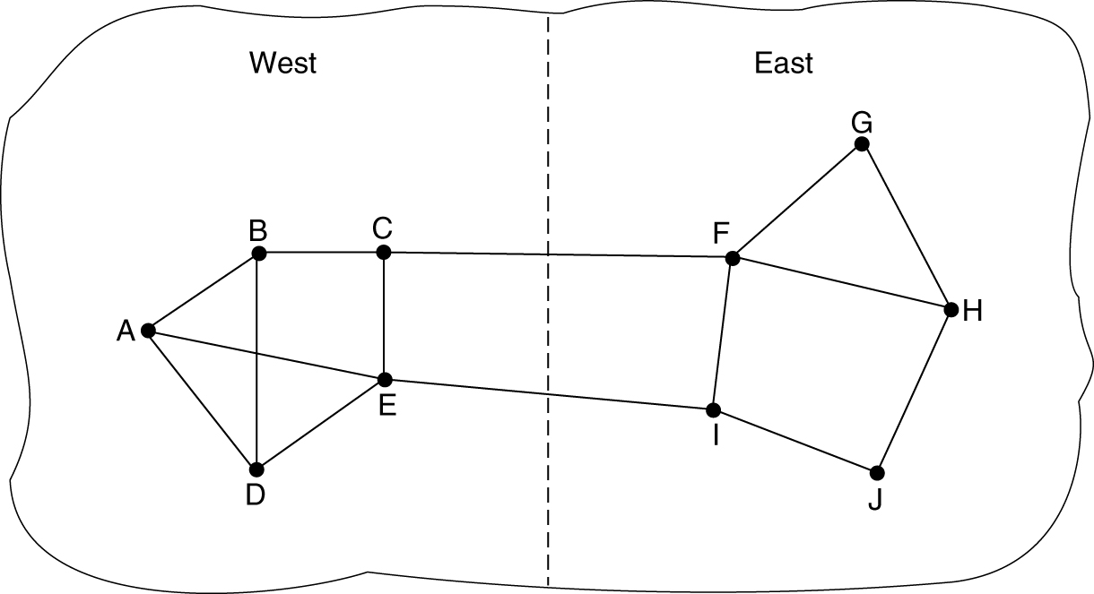
Measuring Line Cost
A subnet in which the East and West parts are connected by two lines.

Slide 7
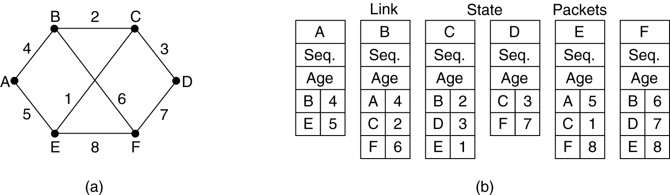
Building Link State Packets
(a) A subnet. (b) The link state packets for this subnet.

Slide 8
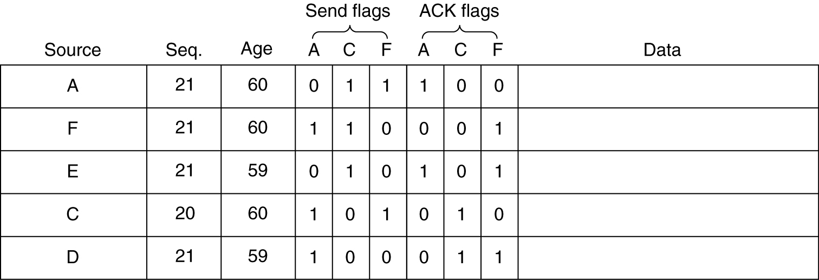
Distributing the Link State Packets
The packet buffer for router B in the previous slide (Fig. 5-13).

Slide 9
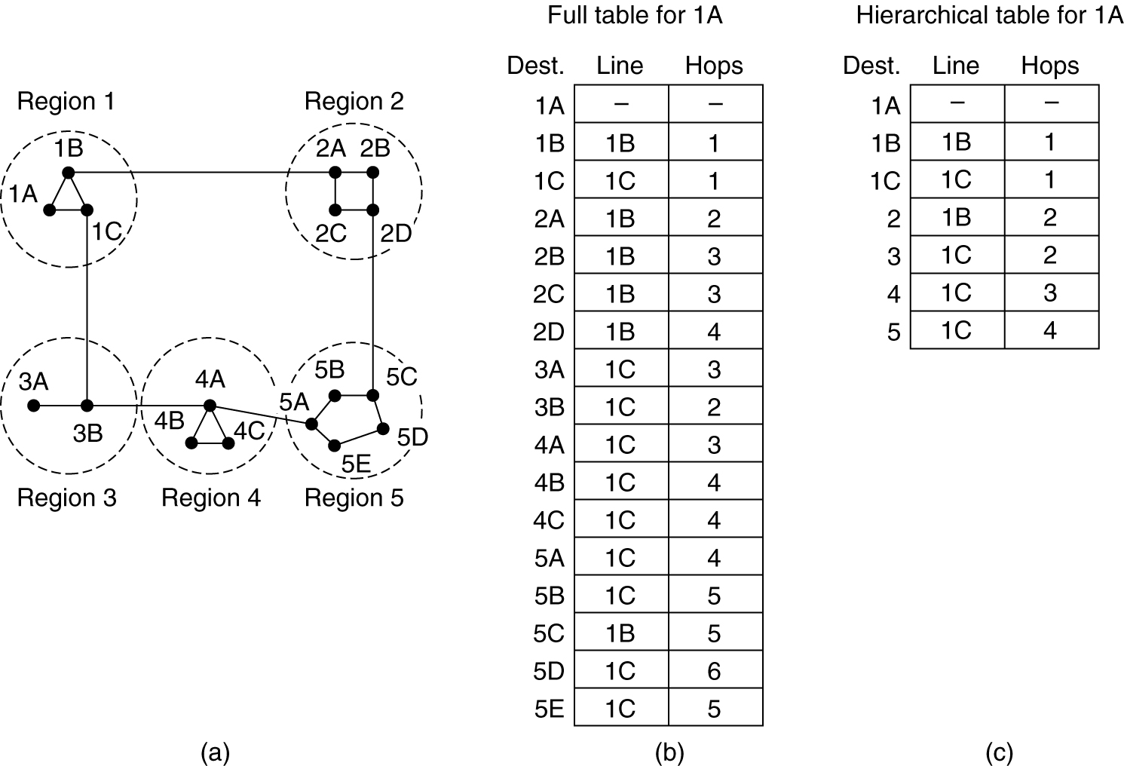
Hierarchical Routing
Hierarchical routing.

Slide 10
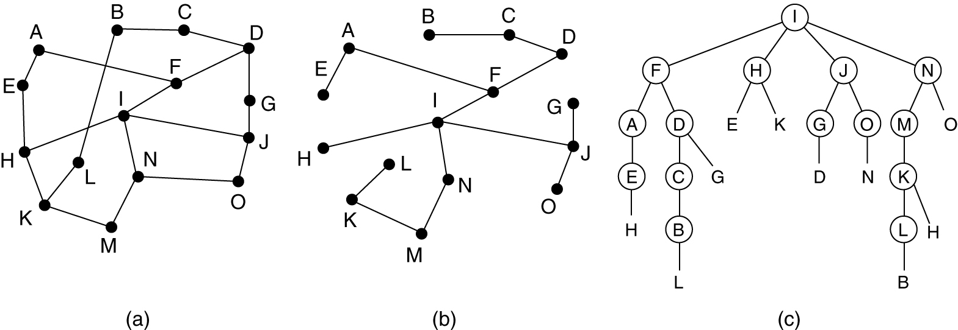
Broadcast Routing
Reverse path forwarding. (a) A subnet. (b) a Sink tree. (c) The tree built by reverse path forwarding.

Slide 11
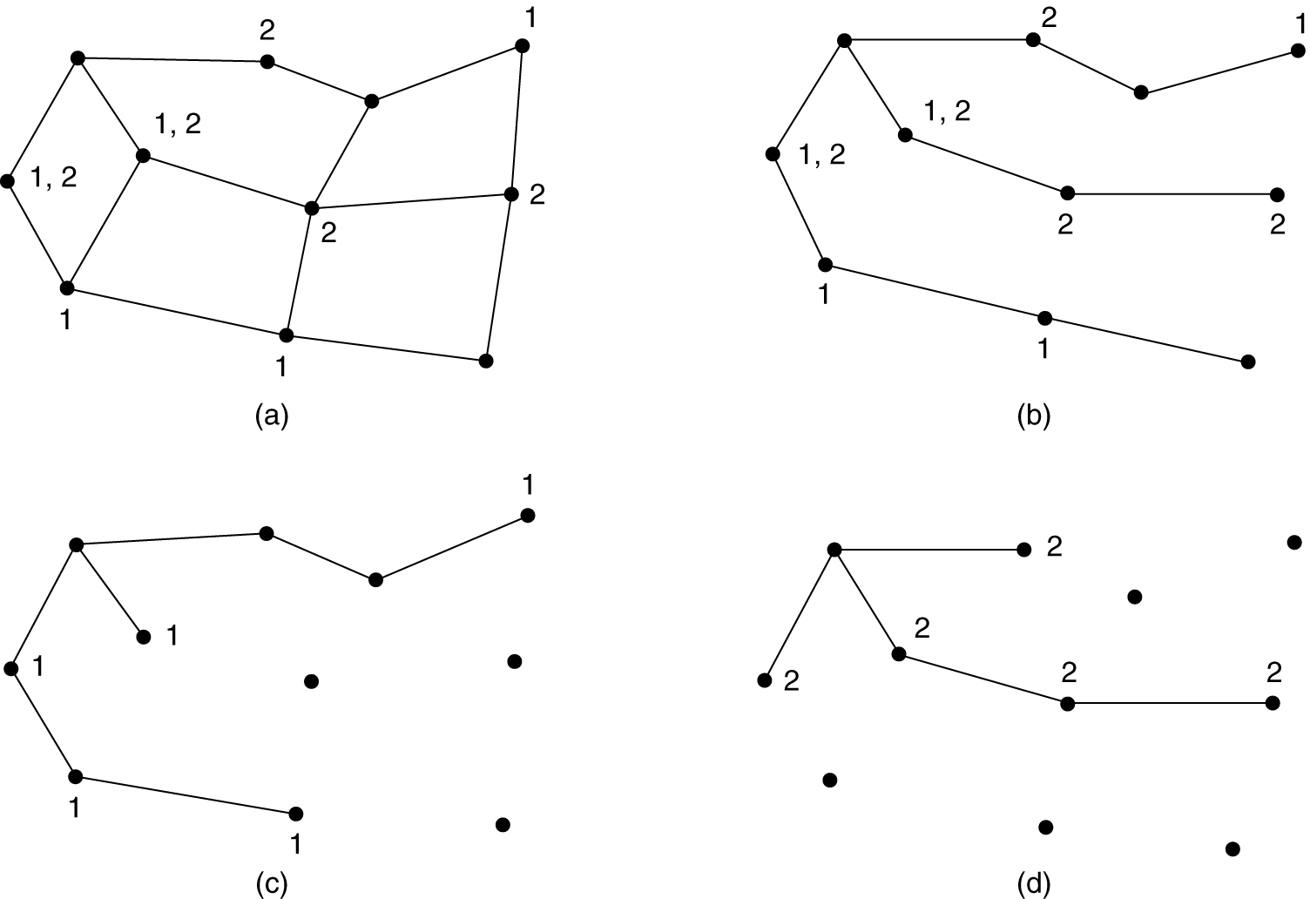
Multicast Routing
(a) A network. (b) A spanning tree for the leftmost router. (c) A multicast tree for group 1. (d) A multicast tree for group 2.

